Slide 1
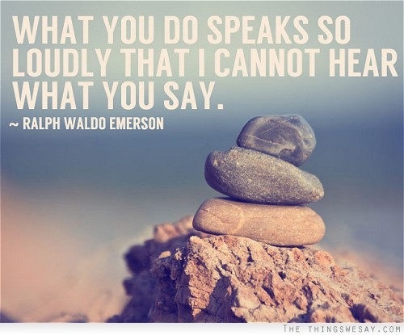
Non verbal communication

Slide 2
task. 1
Guess the name:
One participant performs without voice on the instructions of the other participant while the opposite group guesses.
Guess the name of a movie.
Guess the song
Guess the name of the country

Slide 3
What is non-verbal communication?
Nonverbal communication refers to communication, intentional or unintentional, that is produced by some means other than words (eye contact, body language, or vocal cues, for example) (Knapp & Hall, 2002).
It includes body movement, gestures and facial expressions, tone etc.
These behaviors convey information that words alone often do not.

Slide 4
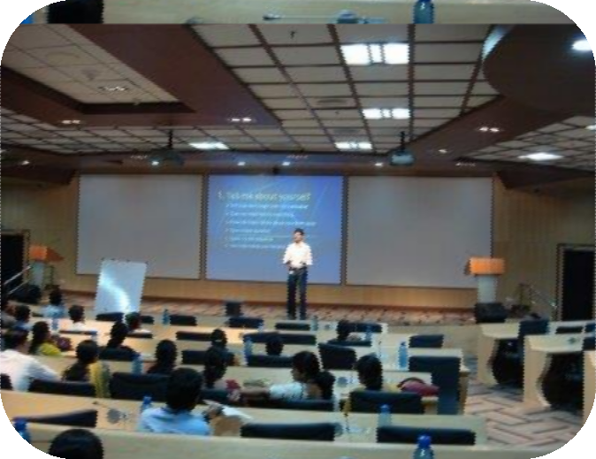
THE ELEMENTS OF DELIVERY
The Voice
Pitch – high or low
Tone – happy, sad, humorous
Clarity
Pauses
Word stress
Pronunciation
Exercise on page 103
Eye Contact
Face
Posture
Gesture
Language
Using Visual Aids

Slide 5
Function:
The five primary functions of Nonverbal Behavior (Argyle, 1988) are:
1. Expression of Emotion — emotions are expressed mainly through the face, body, and voice.
2. Communication of Interpersonal Attitudes — the establishment and maintenance of relationships is often done through nonverbal signals (tone of voice, gaze, touch, etc.).
3. Accompany and Support Speech — vocalization and nonverbal behaviors are synchronized with speech, in conversation (nodding one’s head, responds i.e. “uh huh,” hmm, ok, etc.).
4. Self-Presentation — presenting oneself to another through nonverbal attributes like appearance, artifact/attire, physical appearance.
5. Rituals — the use of greetings, handshakes, hugs or other rituals.

Slide 6
Nonverbal communication
Spoken Word 7%
Gestures
Appearance
Attitude
Attire
Body Language 55%
Tone of Voice 38%

Slide 7
Addressing the Weaknesses of Oral Communication
Break the habit of speaking spontaneously. Use it as a tool to accomplish objectives. So, think about your message, aim, receiver, context, etc to be successful.
Think about the consequences of what you want to say.
Organize your thoughts in a logical way, or a way suiting your audience.
Edit your remarks mentally.
Try to predict your audience’s response and have alternative approaches ready for an unexpected remark.

Slide 8
Addressing the Weaknesses of Oral Communication
While speaking, observe the non-verbal feedback of the listeners and tailor your message accordingly.
Be empathetic.
Use appropriate non-verbal communication.
Be clear.
Be confident. Believe in what you say.

Slide 9
Nonverbal messages can:
Enhance or interfere with verbal messages that are delivered.
They may contradict with verbal messages. (in an interview verbal tells knowledge while non verbal shows how sure and confident you are.)
Substitute verbal message (eye contact, confident tone, facial expressions show competence and depth of knowledge)
Repeat and emphasize (say I am happy then smile and shake hands)
Regulate verbal messages (based on verbal and non verbal experience, interviewer can ask more questions or cut it short.)

Slide 10
PROFESSIONAL IMAGE-Image is as important as content.
What you look like, how you speak, and how you present yourself is just as important as the content of the words that you say.
Consists of:
Personal Appearance
Clothing
Grooming
Personal behavior
Communication effectiveness
Manners
Etiquette
Judgments are made about people based on the professional image they
display as a result of appearance and behavior.

Slide 11
Negative Body Language
Checking the time
Looking at ground
Touching your face
Picking at something
On the edge
Tapping
Objects
Too close
Fake smile
Over blinking

Slide 12
Vital signals/types of non-verbal communication.

Slide 13
Vital signals/types of non-verbal communication.
There are several distinct categories of nonverbal communication
Kinesics, body language showed through arms, fingers, expressions, postures.
Proxemics-Space involving the physical distance: intimate, personal, social and public, how you stand or sit, whether your arms are crossed etc.
Haptic communication- Touch.
Time-chronemics (giving importance to time- being early, late or on tame conveys a lot.)
Paralanguage (how you say something to mean what you want using intonation, pitch and speed of speaking, hesitation noises, gesture, and facial expression.)

Slide 14
Vital signals/types of non-verbal communication.
Gestures
Include movements of the head, hands, eyes, and other body parts. Often used in place of words, gestures are one of the most obvious and common forms of nonverbal communication.
Gestures may also be used when speech is ineffective (e.g., a language barrier) or insufficient (e.g., complex content in the message).
Gestures serve to emphasize, clarify, or add to the verbal content of a message.
Gestures may also be involuntary or subconscious. This is referred to as “leakage” when the true feelings or attitudes are revealed.

Slide 15
Vital signals/types of non-verbal communication.
Facial Expressions
One of the most important and observed
nonverbal communication.
Provide a rich source of information
regarding emotions.
Facial Expressions of many emotions such as happiness, sadness, and fear, are biologically determined, universal, and are learned similarly across cultures.

Slide 16
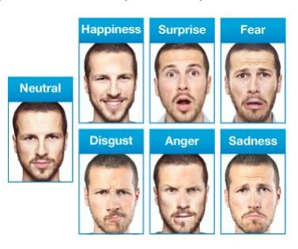

Slide 17
Vital signals/types of non-verbal communication.
Gaze Patterns
Gaze is a form of communication as well as a method for collecting information.
Gaze patterns may be used to assess how others appear, to regulate conversation, or express feelings and emotions.
Gaze serves three primary functions:
1.Monitoring: (e.g., an interviewee is monitored)
2.Regulating: using gaze to regulate the conversation
3.Expressing feelings and emotions

Slide 18
Vital signals/types of non-verbal communication.
Personal Space (proxemics)
Everyone has a personal space, or territory, that provides that individual with a sense of identity, security, and control.
Intimate distance = up to 1.5 feet apart.
Personal distance = 1.5 to 4 feet apart (about arms length).
Social distance = 4 to 12 feet apart
Public distance = more than 12 feet apart

Slide 19
Vital signals/types of non-verbal communication.
Position
Most interactions between the professionals require face-to-face communication.
Facing straight, create hurdles.
A position leaning slightly towards the patient express warmth, caring, interest, acceptance, and trust.

Slide 20
Vital signals/types of non-verbal communication.
Posture
Refers to the position of the body and limbs as well as muscular tone.
Posture may reveal a great deal about emotional status.
A crucial aspect for showing confidence is the maintenance of a relaxed and open posture. (i.e. in an interview)

Slide 21
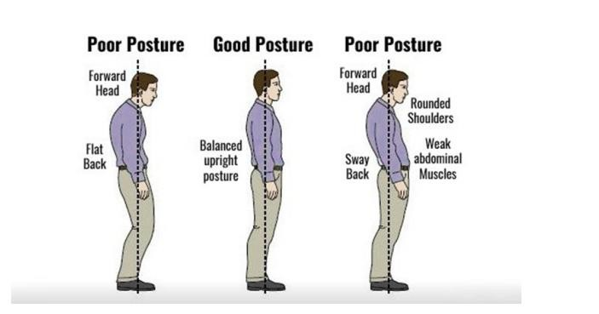
Posture
Means “an attitude or position of body”
The way, in which we sit or stand, walk in walk out tells a lot about us.

Slide 22
Task: q.1 Why nonverbal communication matters? Considering a situation of an interview, brainstorm the ideas. Q.2 If rejected in an interview due to nonverbal communication, what can be some of such reasons behind?

Slide 23
Why nonverbal communication matters:
The way you listen, look, move, and react tells the other person whether or not you care, if you’re being truthful, and how well you’re listening.
When your nonverbal signals match up with the words you’re saying, they increase trust, clarity, and rapport. When they don’t, they generate tension, mistrust, and confusion.

Slide 24
Why nonverbal communication matters:
Be more sensitive not only to the body language and nonverbal cues of others, but also to your own.
What you communicate through your body language and nonverbal signals affect how others see you, how well they like and respect you, and whether or not they trust you.

Slide 25
Why nonverbal communication matters:
In order to send accurate nonverbal cues, you need to be aware of your emotions and how they influence you. You also need to be able to recognize the emotions of others and the true feelings behind the cues they are sending.
Interpersonal dominance may be characterized as having five interrelated dimensions, many of which are
communicated nonverbally. They include: persuasiveness
or influence, conveying focus and grace, conversational
control, and self-assurance,

Slide 26
Interpretation of nonverbal communication
Successful communication requires congruency between the verbal and nonverbal messages,
In some instances, behavioral observation may be the only mechanism by which Professionals may derive information from.
For example, a patient may be speech impaired (e.g., due to stroke or intubation), to young, too sick, or simply unwilling to communicate verbally.

Slide 27
Impression Management:
Impression Management is an individual’s conscious attempt at control over communicative behavior and cues for the purposes of making a desired impression (often with nonverbal communication).

Slide 28
Impression Management:
The impressions we make on others are defined by four dimensions: credibility (how competent and trustworthy they are), likeability, interpersonal attractiveness, and dominance (showing power and assertiveness).
Factors that influence the impressions we form about other people are: a) Stereotypes b) First impressions c) Selective perceptions based on our own past experiences and concerns; and d) Last impressions.

Slide 29
Facial Management Techniques
Intensifying – to exaggerate a feeling
Deintensifying – to underplay/curtail a feeling
Neutralizing – to hide a feeling
Masking – to replace or substitute the expression of one emotion or another

Slide 30
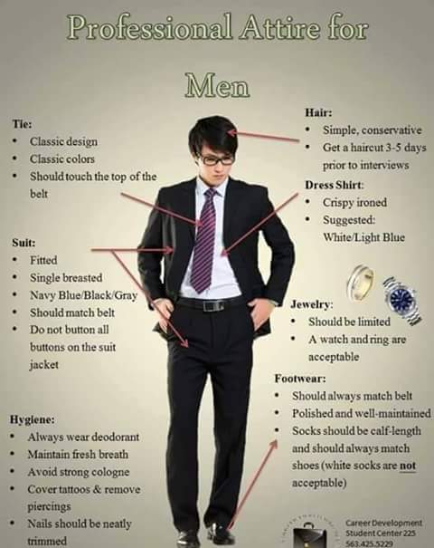
MEN’S BUSINESS CASUAL

Slide 31
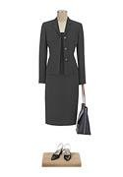
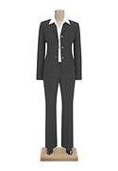
WOMEN BUSINESS WEAR

Slide 32
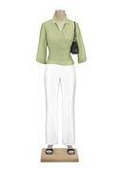
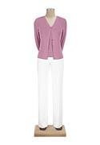
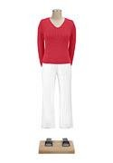
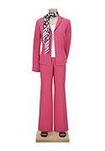
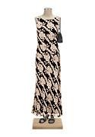
WOMEN’S BUSINESS CASUAL

Slide 33
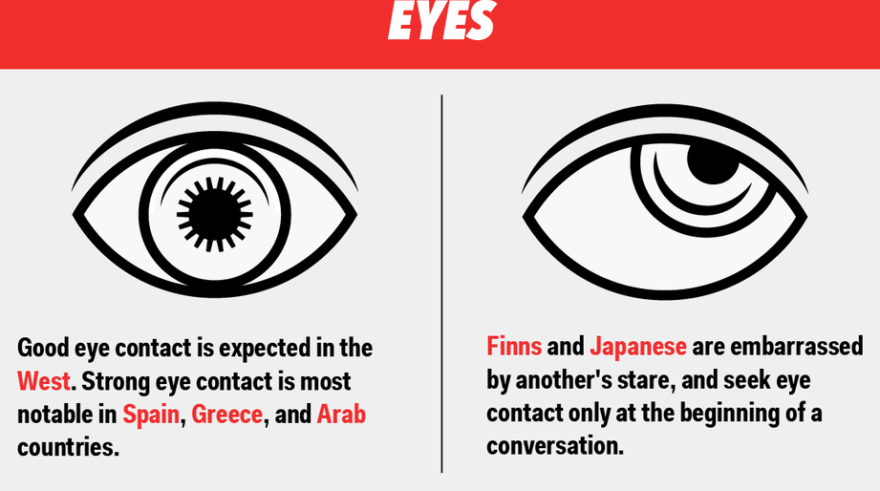

Slide 34
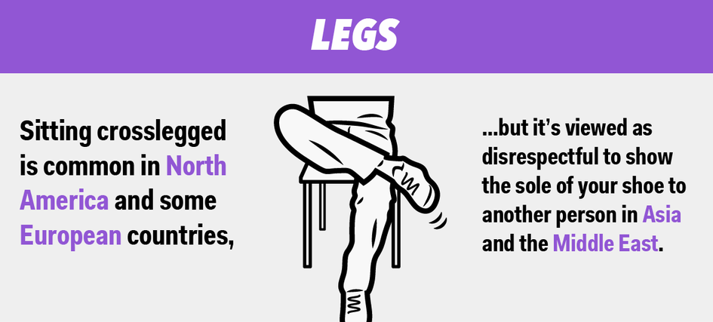

Slide 35
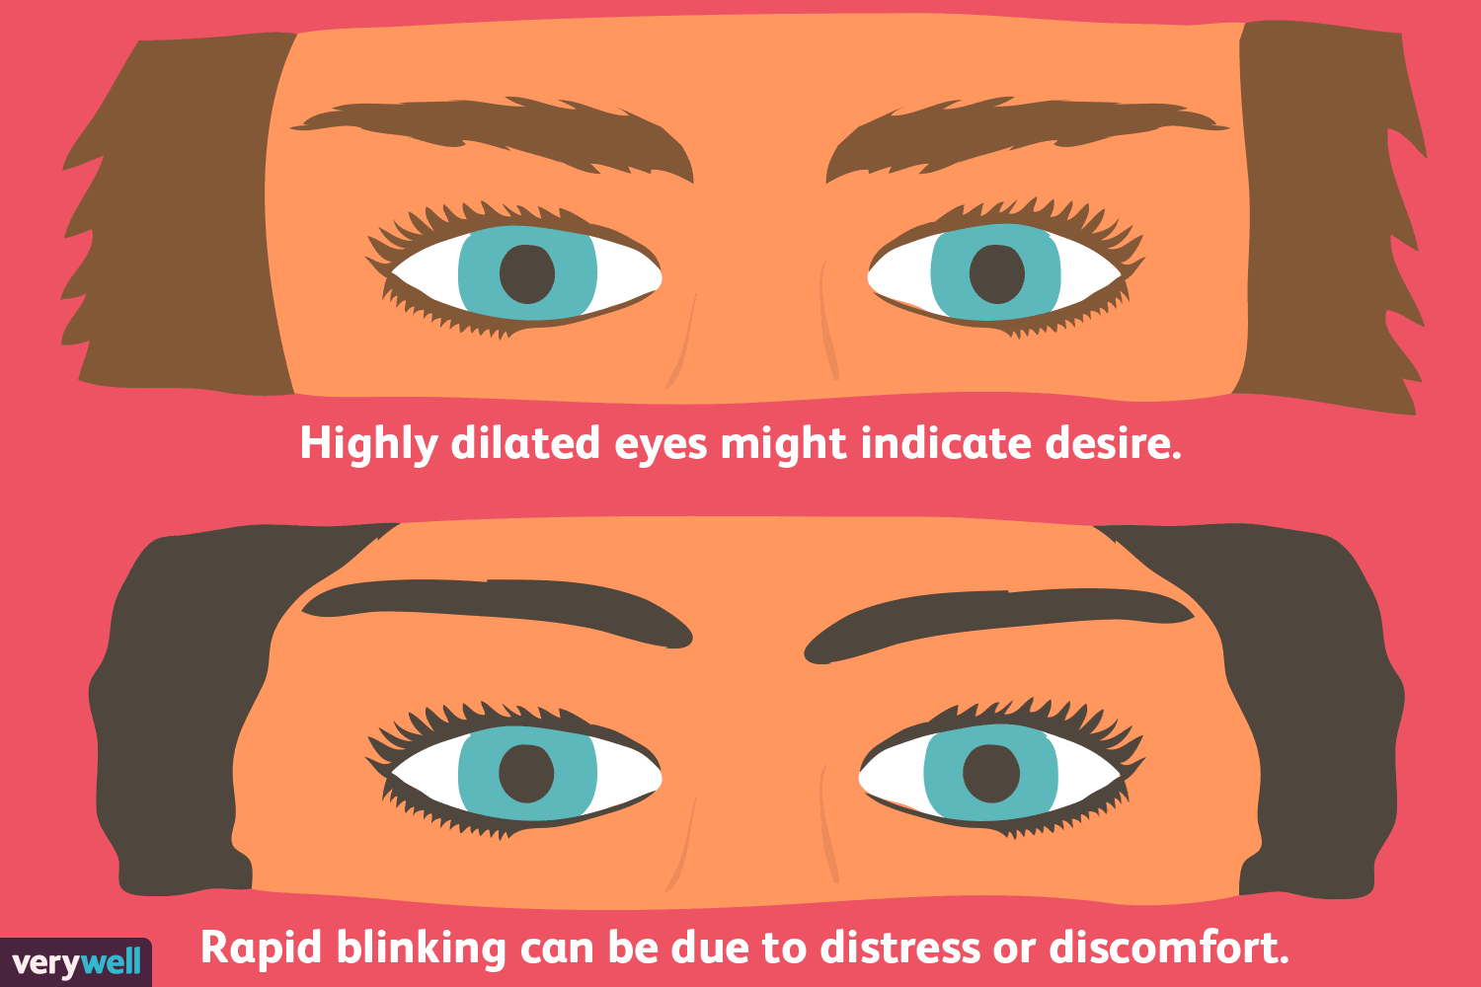

Slide 36
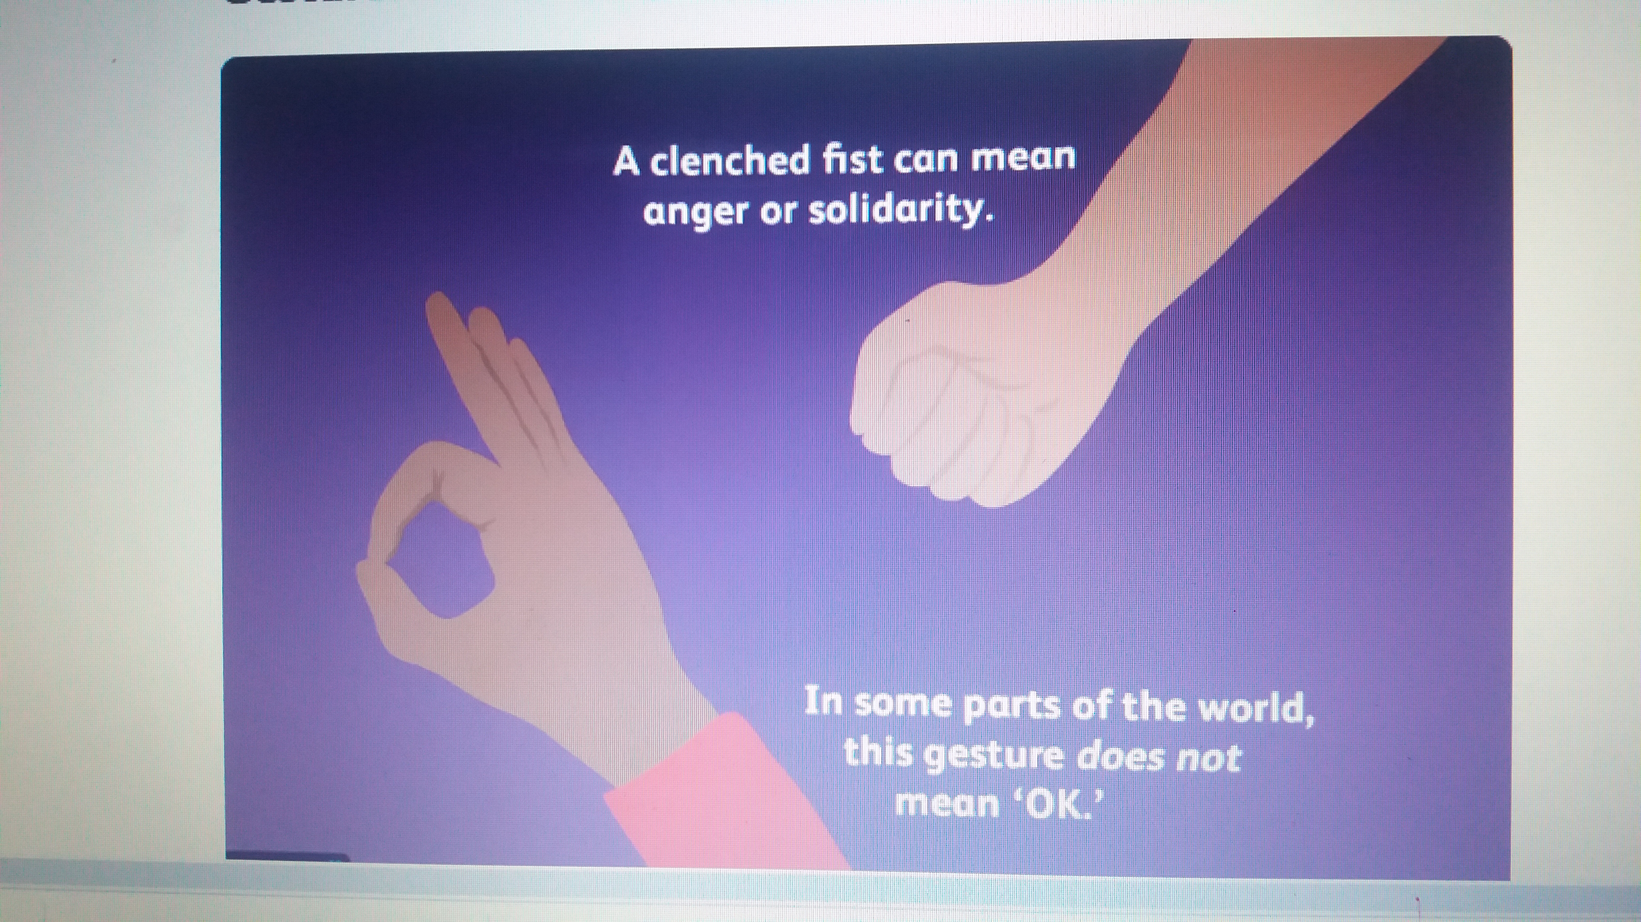

Slide 37
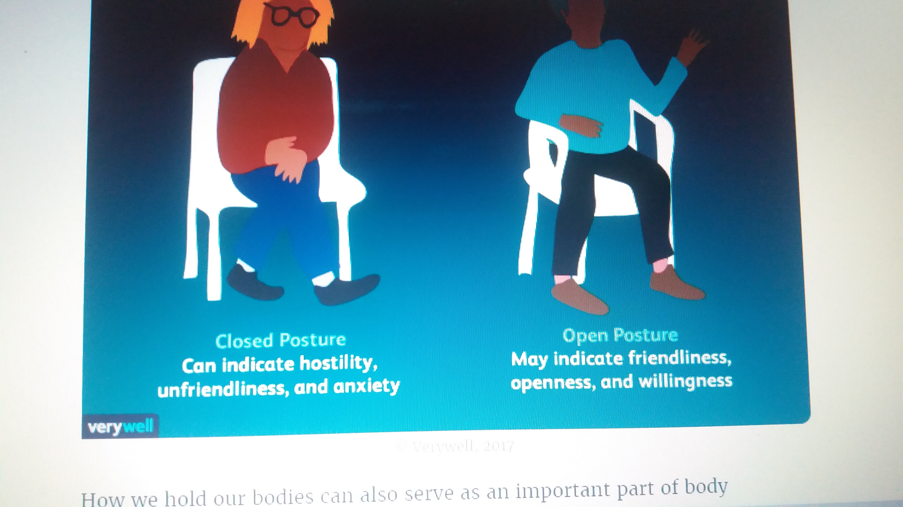

Slide 38
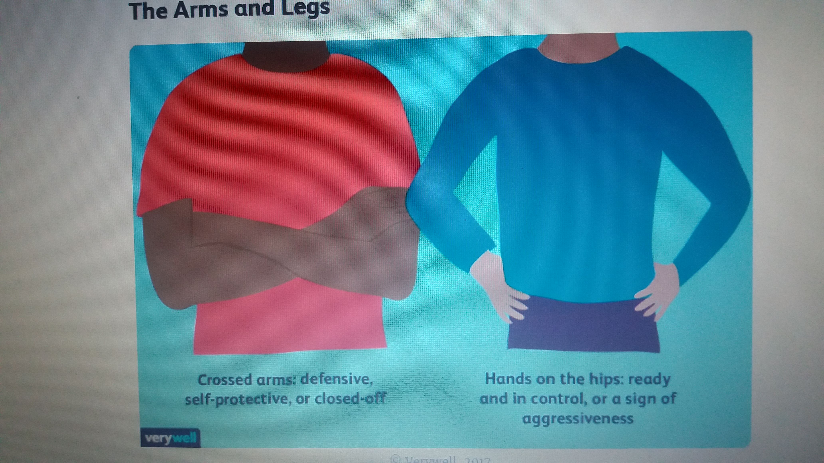

Slide 39
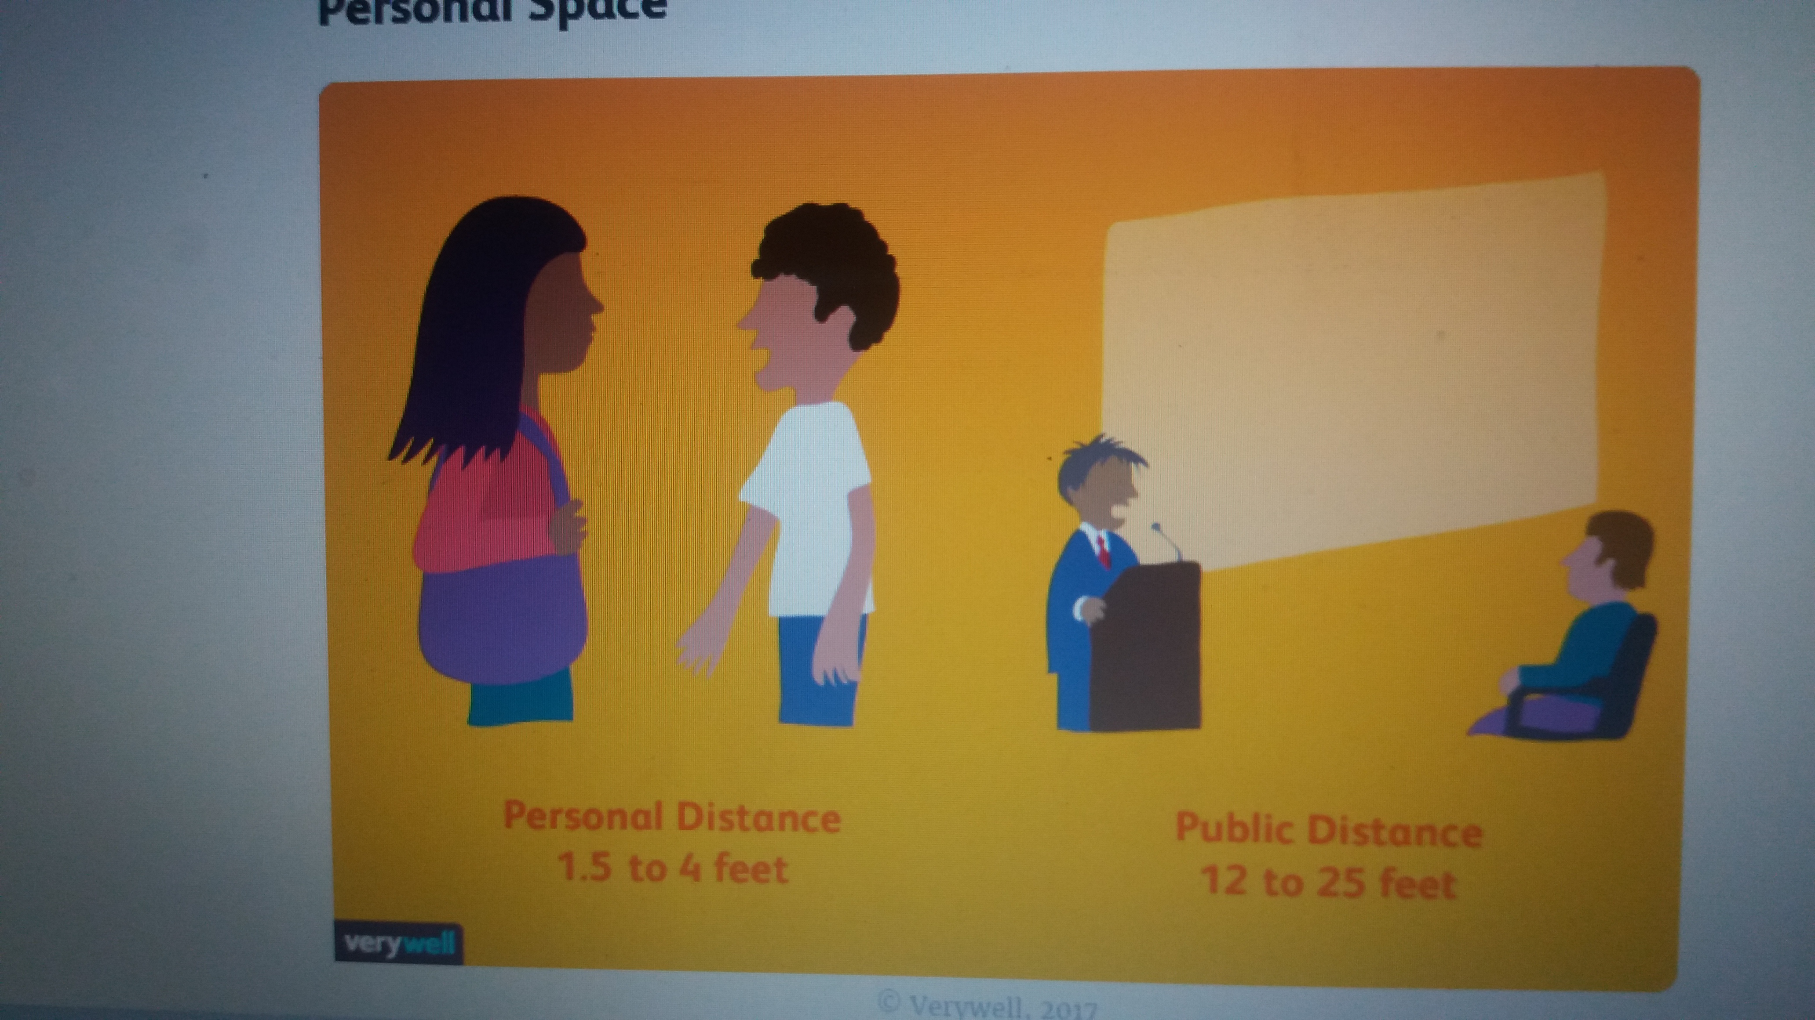

Slide 40
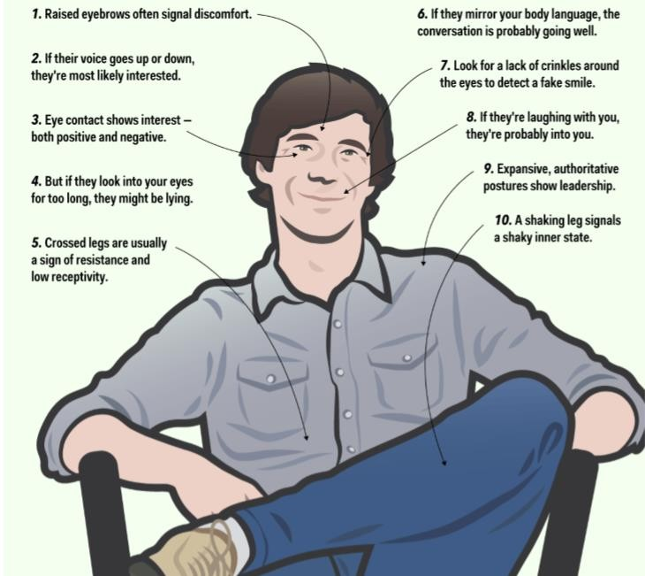

Slide 41
Body language and possible meanings:
Bowed posture, twiddling thumbs: Indicate either frustration or anger.
Steepled hands, sprawling sitting position: Confidence, self trust, position.
Rubbing hand through hair: Indicate frustration or deep thought.
Open hands, unbuttoned coat: Openness, friendliness, and equality.
Wringing hands, tugging ears: Signs of insecurity and doubt.
Shrugging of shoulders: indicates indifference & unconcern.
Waving of hand to indicate good bye or draw the attention of a person

Slide 42


“BRAND YOU”--THE PACKAGE OVERVIEW
 | IMAGE & APPEARANCE | SPEECH | ETIQUETTE & SOCIAL SKILLS | NONVERBAL CUES
 | PERSONAL APPEARANCE— OVERALL IMAGE | VOCAL TONE & RYTHM | USE OF TIME & SPACE PUNCTUALITY, & PERSONAL SPACE / COMFORT ZONES | FACIAL & EYE EXPRESSONS SMILING, FROWNING, DIRECT EYE CONTACT, EYE-ROLLING,
 | PERSONAL GROOMING & CLEANLINESS HAIR, MAKEUP, SHAVEN, TEETH, BREATH, BODY ODOR, FINGERNAILS | VOLUME , PITCH, & PACE | TOUCHING PROTOCOL GREETINGS = HANDSHAKES,HUGGIN G, KISSING, BOWING, ETC. | GESTURES & POSTURE NODDING, SHRUGGING, SCRATCHING HEAD, PLAYING WITH HAIR, SLOUCHING, YAWNING
 | PERSONAL STYLE--CLOTHING & ACCESSORIES STYLE & COLOR | STYLE FORMAL OR CONVERSATIONA L | SOCIAL PROTOCOL DINING MANNERS, CONVERSATIONAL RULES, & CELL PHONES | ATTITUDE & SELF ESTEEM POSITIVE OR NEGATIVE? SELF-CONFIDENCE LEVEL?

Slide 43
NONVERBAL COMMUNICATION “THE ENTRANCE”
DON’T:
TURN YOUR BACK ON THE
AUDIENCE
LOSE EYE CONTACT
HAVE A LIMP HANDSHAKE
FIDGET, SQUIRM, SLOUCH
SPEAK TOO SOFTLY TO BE HEARD CLEARLY
CHEW GUM
APPEAR DISINTERESTED
DO:
MAKE AN ENTRANCE
COMMAND ATTENTION
PROPER POSTURE
SMILE WITH CONFIDENCE
FIRM HANDSHAKE
DIRECT EYE CONTACT
SPEAK LOUDLY ENOUGH TO BE HEARD CLEARLY
DRESS APPROPRIATELY

Slide 44
NONVERBAL CUES
FACIAL & EYE EXPRESSONS
SMILING OR FROWNING
RAISING EYEBROWS
PURSING LIPS
CRINKLING NOSE
SQUINTING
EYE CONTACT
DIRECT
INDIRECT
EYE-ROLLING
LOOKING AROUND / NOT MAKING EYE CONTACT
APPEARING BORED OR DISINTERESTED OR DISTRACTED
 GESTURES & POSTURE
NODDING / SHAKING HEAD
SHRUGGING
SCRATCHING HEAD
PLAYING WITH HAIR
SLOUCHING
YAWNING
STIFF OR RELAXED POSTURE
CROSSED LEGS / SWINGING OR BOUNCING LEG
TAPPING TOES OR FINGERS

Slide 45
NONVERBAL CUES
 ETIQUETTE
= KNOWING HOW TO ACT IN A GIVEN
SITUATION
SOCIAL PROTOCOL
DRINKING & DINING MANNERS
CONVERSATIONAL RULES
USE OF CELL PHONES IN PUBLIC
USE OF NAMES
INTRODUCTIONS
SEATING ORDER
USE OF PROFANITY
SMOKING IN PUBLIC
COUGHING, YAWNING, SCRATCHING, ETC. IN PUBLIC
SOCIAL SKILLS
USE OF TIME PUNCTUALITY USE OF TIME TO DEMONSTRATE POWER
USE OF SPACE PERSONAL SPACE / COMFORT ZONES USE OF SPACE TO ASSERT AUTHORITY SEATING ARRANGEMENTS
TOUCHING PROTOCOL GREETINGS = HANDSHAKES,HUGGING, KISSING, BOWING, ETC.

